Slide 1
A2 — ns-3 Setup & First Scenario
ns-3.48 · AI generated 3GPP video streaming traffic model
Lubin OUISSE · E11502007

Slide 2
ns-3 install and build
Version
Build
Tests
ns-3.48 all in one on MacOS 15.8.1
Downloaded from the ns-3 website
Built successfully by following the README
Issue with CMake
Ran test.py to check the build. All 1000 tests passed
2/9

Slide 3
3GPP video streaming traffic model
Frames
Packet size
Inter-arrival time
100 ms
20–250 B
2.5–12.5 ms
One frame every 100 ms, split into 8 packets.
Truncated Pareto: k = 20 B, α = 1.2, max 250 B.
Within a frame. Truncated Pareto: k = 2.5 ms, α = 1.2, max 12.5 ms.
3/9
Notes:
Before presenting, check these parameters against TS 26.926 and update this slide if they differ.

Slide 4
Run results
4,720
50.0 kbps
10.13 ms
packets sent and 4,720 received. No loss.
throughput, far below the 5 Mbps link capacity.
mean delay: 10 ms propagation plus about 0.13 ms transmission.
4/9

Slide 5
What broke and how it was fixed
Issue | Cause | Fix
Compile error on SIZE_MAX and g_log | Variable names colliding with MacOS | Renamed to PKT_SIZE_MAX and g_txLog
pip install refused | Externally managed Python on macOS | pipx did not help because it isolates libraries; a virtual environment worked
5/9

Slide 6
6/9

Slide 7
Verifying the generated distributions
Statistic | Packet size | Inter-arrival
Samples | 4,720 | 4,130
Mean | 50.1 B | 4.75 ms
Min | 20 B | 2.50 ms
Max | 250 B | 12.50 ms
7/9

Slide 8
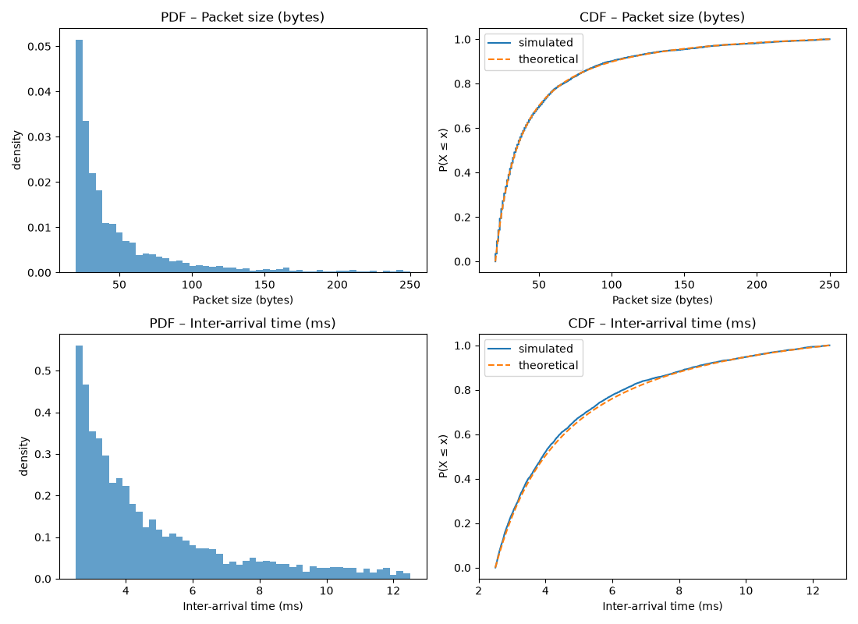
8/9

Slide 9
Conclusion
The ns-3.48 build works and passes all 1000 tests.
The generator reproduces the intended Pareto distributions: simulated CDFs match theory.
Means sit below the untruncated Pareto means because the tail is cut at the maximum.
9/9

